Slide 1
Design of City-wide Heating Network
Network Design case solved by Quantum Computing
The slides are a work in progress. This document is a draft for exchange of ideas. It is not a well-checked proposal or a verified technical presentation.

Slide 2







Understanding of core problem
City-wide network of water pipes
Multiple known source/supply locations
With known capacity
With known costs of generation
Multiple known demand/destination locations
With known requirement
Option A: Connections (or pipes)
Connect a pair of nodes
Known capacity of flow
Known distance or loss function
Option B: Intermediate connector nodes
Neither source nor destination
Used for routing, re-directing and control of flow

Slide 3
Understanding of core problem
City-wide network of water pipes
Multiple known source/supply locations
With known capacity
With known costs of generation
Multiple known demand/destination locations
With known requirement
Option A: Connections (or pipes)
Connect a pair of nodes
Known capacity of flow
Known distance or loss function
Option B: Intermediate connector nodes
Neither source nor destination
Used for routing, re-directing and control of flow

Slide 4
Understanding of core problem
City-wide network of water pipes
Multiple known source/supply locations
With known capacity
With known costs of generation
Multiple known demand/destination locations
With known requirement
Option A: Connections (or pipes)
Connect a pair of nodes
Known capacity of flow
Known distance or loss function
Option B: Intermediate connector nodes
Neither source nor destination
Used for routing, re-directing and control of flow

Slide 5
Understanding of core problem
City-wide network of water pipes
Multiple known source/supply locations
With known capacity
With known costs of generation
Multiple known demand/destination locations
With known requirement
Option A: Connections (or pipes)
Connect a pair of nodes
Known capacity of flow
Known distance or loss function
Option B: Intermediate connector nodes
Neither source nor destination
Used for routing, re-directing and control of flow

Slide 6
Understanding of core problem
City-wide network of water pipes
Multiple known source/supply locations
With known capacity
With known costs of generation
Multiple known demand/destination locations
With known requirement
Intermediate connector nodes
Neither source nor destination
Used for routing, re-directing and control of flow
Connections (or pipes)
Connect a pair of nodes
Known capacity of flow
Known distance or loss function

Slide 7





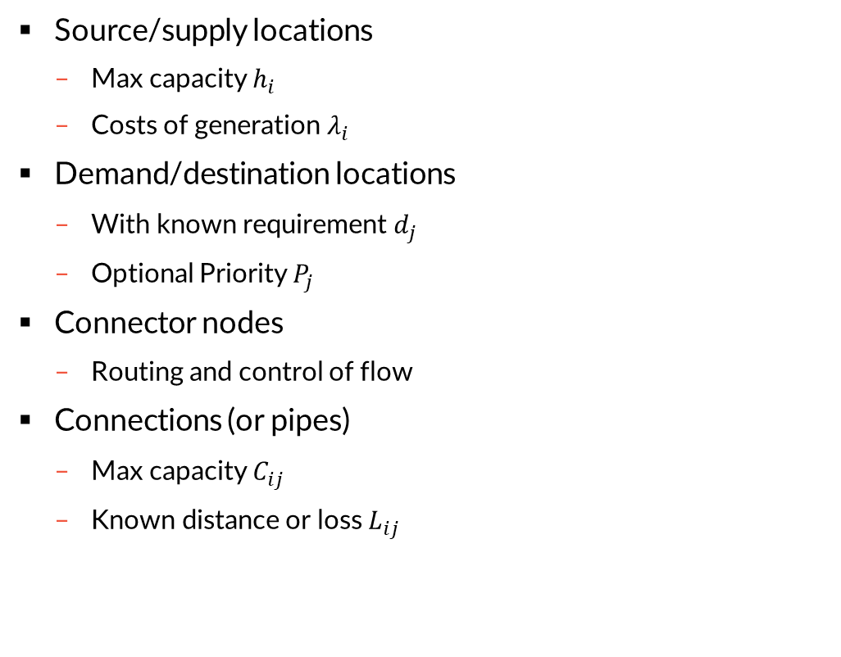

Possible Constraints
Source/supply locations
Max capacity $h_{i}$
Costs of generation $λ_{i}$
Demand/destination locations
With known requirement $d_{j}$
Optional Priority $P_{j}$
Connector nodes
Routing and control of flow
Connections (or pipes)
Max capacity $C_{ij}$
Known distance or loss $L_{ij}$
$$λ_{i}$$
$$h_{i}$$
$$L_{ij}$$
$$C_{ij}$$
$$P_{j}$$
$$d_{j}$$

Slide 8

Possible Objectives
Cost Minimization – We can meet all demands already
Objective Function: Maximize $\sum_{ij}{{λ_{i} h}_{i}}$
Demand Fulfillment – We cannot meet all demands
Objective Function: Minimize $\sum_{ij}{{P_{j} d}_{i}}$
Not mathematically correct. The decision variables are not yet introduced

Slide 9
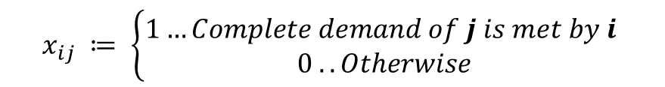
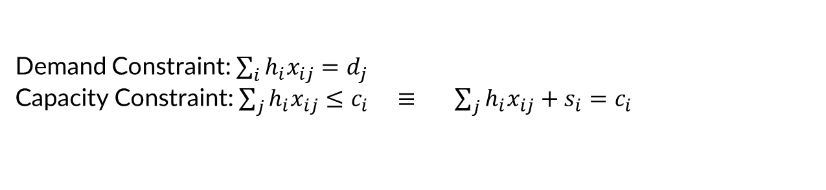
Decision Variables
$$x_{ij} ≔ \left\{\begin{aligned}1…Complete demand of j is met by i \\ 0 .. Otherwise\end{aligned}\right.$$
$x_{ij} ≔$ Fraction of demand of j met by i
Demand Constraint: $\sum_{i}{{h_{i}x}_{ij}=d_{j}}$
Capacity Constraint: $\sum_{j}{{h_{i}x}_{ij}≤c_{i}} ≡ \sum_{j}{{h_{i}x}_{ij}+s_{i}=c_{i}}$
Still not yet mathematically correct. The decision variables are not yet complete for

Slide 10
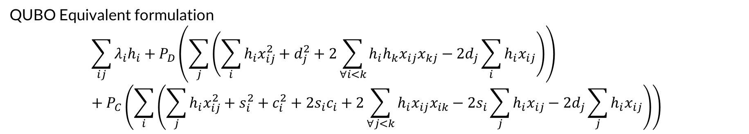
Correlate to Vehicular Network QUBO formulation
QUBO Equivalent formulation
$$\sum_{ij}{{λ_{i}h}_{i}}+P_{D}\left(\sum_{j}{\left(\sum_{i}{{h_{i}x}_{ij}^{2}}+d_{j}^{2}+2\sum_{∀i<k}{h_{i}h_{k}x_{ij}x_{kj}}−2d_{j}\sum_{i}{{h_{i}x}_{ij}}\right)}\right)+P_{C}\left(\sum_{i}{\left(\sum_{j}{{h_{i}x}_{ij}^{2}}+s_{i}^{2}+c_{i}^{2}+2s_{i}c_{i}+2\sum_{∀j<k}{h_{i}x_{ij}x_{ik}}−2s_{i}\sum_{j}{{h_{i}x}_{ij}}−2d_{j}\sum_{j}{{h_{i}x}_{ij}}\right)}\right)$$
https://www.nature.com/articles/s41598-023-38787-2

Slide 11
What-If Analysis
Sensitivity to change: Small shifts can disrupt the entire system.
Reasons behind analysis
Non-linear variations: Network parameters fluctuate unpredictably.
Sensitivity to change: Small shifts can disrupt the entire system.
Predictive modeling: Identifies fluctuation limits and risks.
Adaptive control: Suggests adjustments for stable performance.
Contents of analysis
Demand-based supply: Temperature adjustment to meet requirements.
Predictive forecasting: Supply temperature estimation for the next hour.
Optimal discharge timing: Identifying the right moment for adequate supply.
Storage integration: Incorporating a water tank for system efficiency.

Slide 12
Demand-based Supply
Sensitivity to change: Small shifts can disrupt the entire system.
RHN has different demands and different intervals of time.
Variable demand: RHN requires different supply temperatures at different times.
Manual adjustment: Operators tweak temperatures to match network demand.
Optimized supply: Determining the required temperature for each interval.
How to obtain such supply temperature ?
Demand 00-01 | Demand 01-02 | Demand 02-03 | Demand 03-04
0.000 | 0.000 | 0.000 | 0.000
168.438 | 55.727 | 55.308 | 55.099
181.637 | 59.917 | 59.708 | 59.498
130.100 | 43.157 | 42.738 | 42.738

Slide 13
Optimized Modelling for Demand Fulfilment
Sensitivity to change: Small shifts can disrupt the entire system.
Idealized Network Analysis – No losses; gives lower bound of supply temperature.
Realistic Network Analysis – Maximum load; upper bound limited by boiling temperature.
Optimized Iterative Process – Ensures same mass flow rate, refining supply temperature.
Final Supply Temperature – Obtained after convergence for the queried time interval.

Slide 14
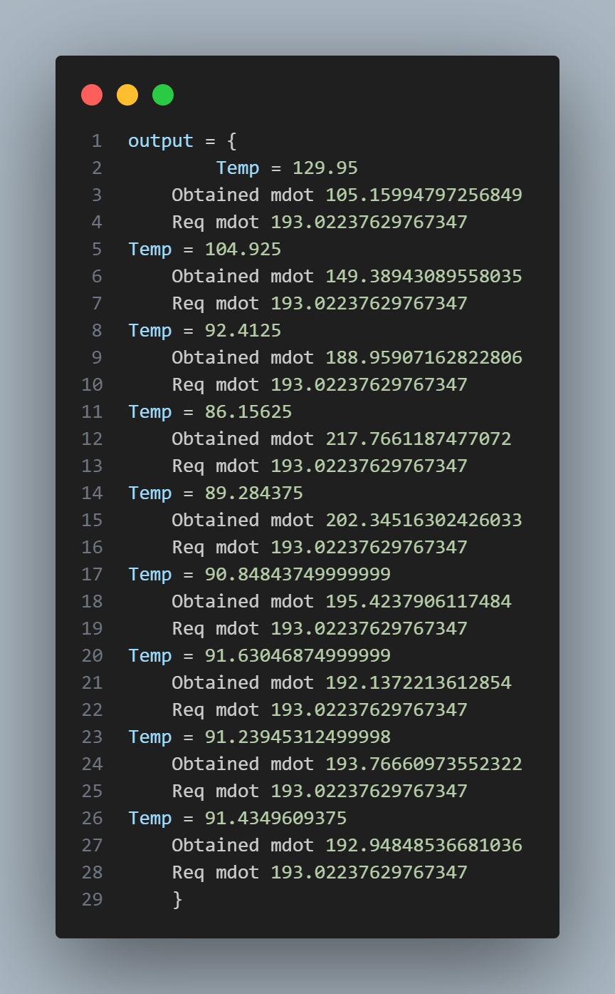
Optimized Modelling for Demand Fulfilment
Sensitivity to change: Small shifts can disrupt the entire system.
Input – Demand for the given time interval.
Lower Bound – Simplified graph model estimates minimum temperature for the same mass flow rate.
Upper Bound – Full-load network analysis determines maximum feasible temperature.
Optimization – Iterative process refines parameters to achieve the best solution.
Solution converges to the most optimal possibility!

Slide 15
Optimal Discharge Timing
Sensitivity to change: Small shifts can disrupt the entire system.
Path Analysis – Multiple routes with known velocities and lengths.
Critical Path – Discharge based on longest travel time.
Temperature Boost – Raised to compensate for max delay.
Final Timing – Set by max travel time across all sinks.

Slide 16
Adjustments and Future work
Sensitivity to change: Small shifts can disrupt the entire system.
Speed Optimization – Develop a more robust and efficient computation method for faster convergence.
Web Integration – Implement an interactive UI with a backend, hosted on the department's local server.
Real-Time Monitoring – Enable live tracking of system parameters through the web interface.
Storage Tank Modeling – Introduce high-temperature storage tanks to meet demand when solutions fail to converge.
Boiling Point Constraint Handling – Adjust supply mechanisms when the required temperature exceeds the boiling point.
Scalability & Flexibility – Enhance the model for future expansions and dynamic operational adjustments.

